Slide 1
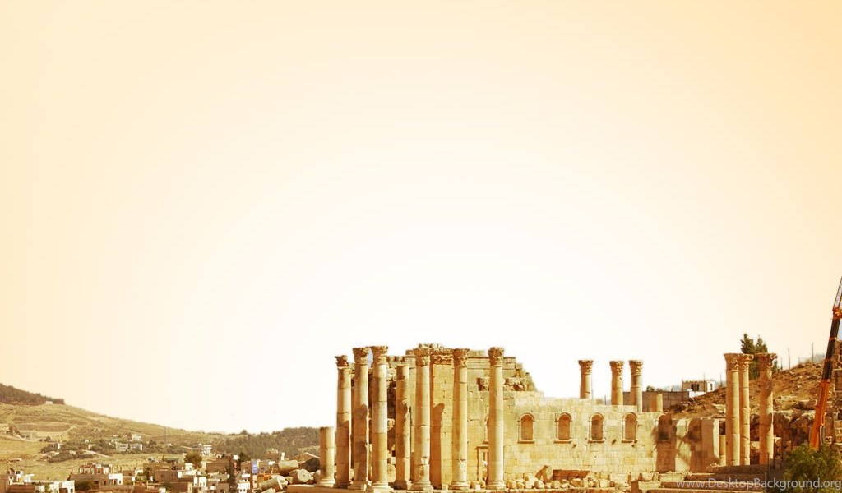
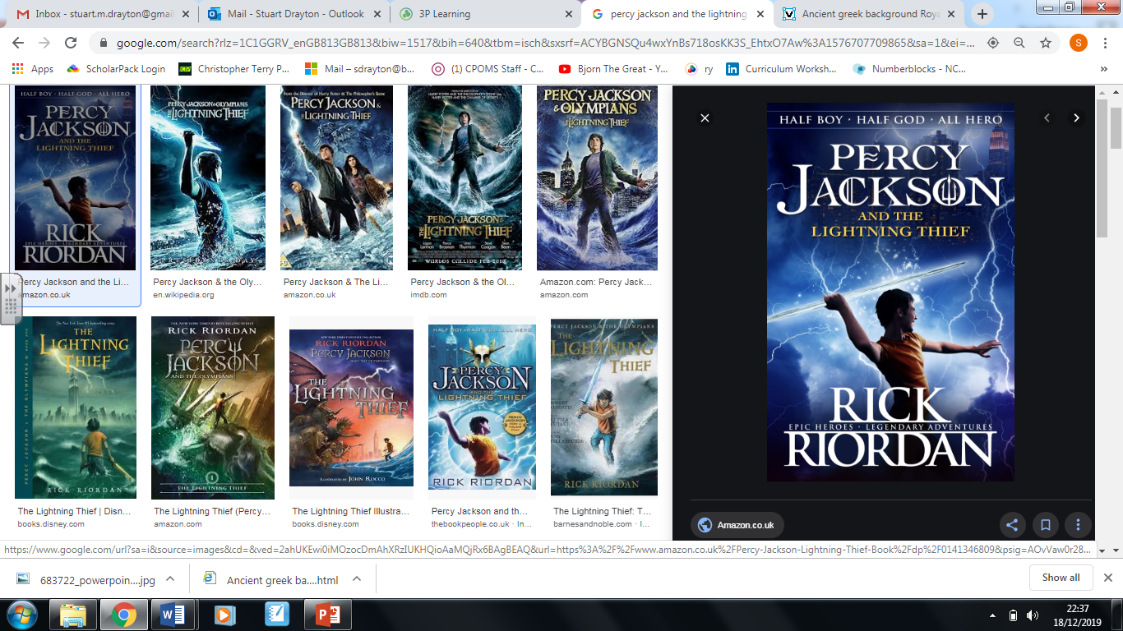
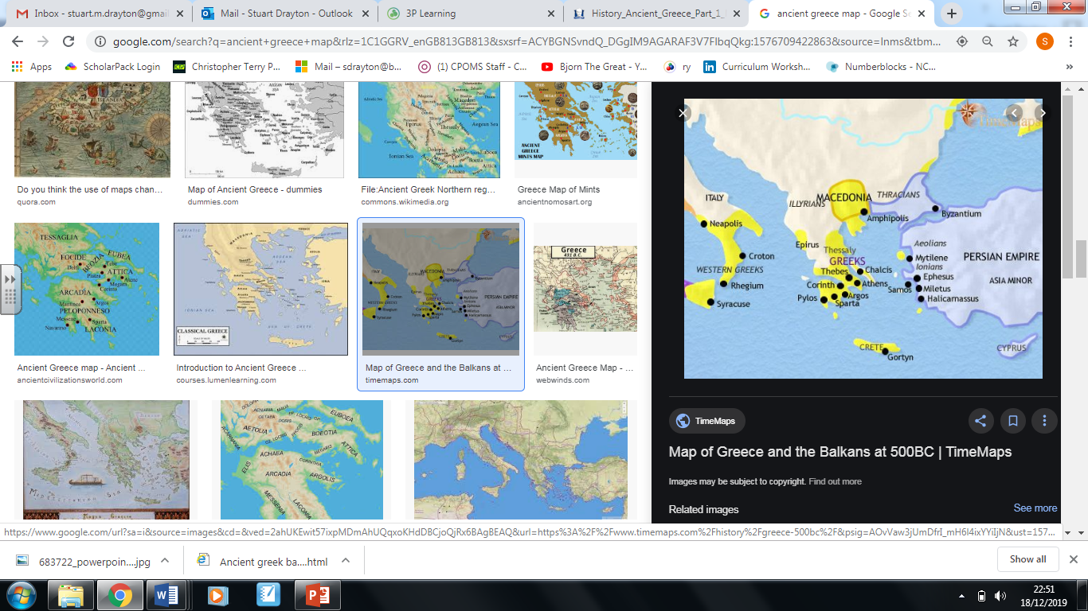

Key Knowledge
Know key dates, characters and events of the Ancient Greeks
Link sources and work out how conclusions were arrived at
Find out about the beliefs, behaviours and characteristics of people, recognising that not everyone shares the same views and feelings
Write another explanation of a past event in terms of cause and effect, using evidence to support and illustrate their explanation
Consider the ways of checking the accuracy of interpretations, fact or fiction and opinion
Confidently use the library and internet for research
Text: Percy Jackson and the Lightning Thief
A superb novel by Rick Riordan which combines modern society with Greek myth, teaching historical understanding within an action packed adventure.
Key Vocabulary
Empire | A group of countries ruled by a single person or sovereign state
Conquest | The act of conquering or ‘taking control’
Citizen | A native or naturalized member of a state or nation
Legacy | Something handed down to a successor
City state | A state consisting of a sovereign city and its dependencies
Religion | Belief in or worship of a supernatural power considered to be divine or to have control over human destiny
Myth | A story about superhuman beings of an earlier age, usually of how natural phenomena or social customs came into existence.
Oligarchy | A type of government where power is held by a few people
Acropolis | A citadel or fortified part of an ancient Greek City, usually built on a hill
Democracy | A system of government where citizens choose leaders or make important decisions using a voting system.
Trireme | Ancient Greek ship with three tiers of oars on each side
Year 6 Spring Term
Big Q: How have the Ancient Greeks influenced our lives today?
Experiences
Greek Theatre group visit
Ancient Greece Day
Minoan (c.2000-1450) and Mycenean (c.1600-1100) civilisations develop Greek culture
c.776BC Traditional date of first Olympic Games
c.490 (Thermopylae) and c.480 (Marathon) are major battles in the Greece-Persian (now Iran) war
c.147-146 Romans conquer Greece and Macedonia
2000 BCE 900BCE 500 BCE 336BC 146 BCE
c.1250BC Traditional date of the Trojan War
C.900-700BC Greek Civilisation grows strong again after two centuries of decline
c.500-430BC Athens leads Greece, creates amazing art, has democratic government
c.336-323BC Alexander the Great of Macedonia and Greece conquers a vast empire

