Slide 1
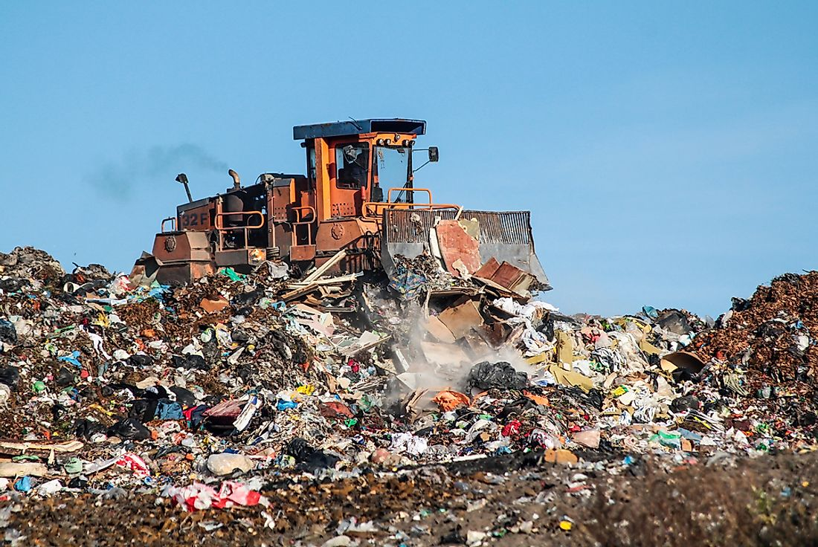
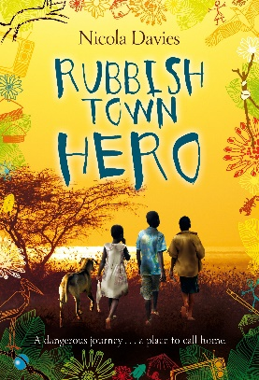
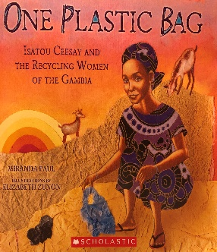
Texts:
Rubbish Town Hero
Chipo and his little sister Gentle live on Papa Fudu's dumpsite in Rubbish Town, searching for valuable things amongst the rubbish to try to stay alive. Life isn't easy - luckily, Chipo has spirit, courage and lots of imagination! And now, he has a plan...
But when Chipo and Gentle are caught with something precious that Papa Fudu wants for himself, they have to think quick, move fast. Suddenly they're on the run...
One Plastic Bag
The inspiring true story of how one African woman began a movement to recycle the plastic bags that were polluting her community.
Key Knowledge:
To understand how we can recycle responsibly and why this is important
To know the impact of landfills on the environment
To comprehend what plastic pollution is and how can we help at Beardall Fields
To describe ‘Climate Change’ and it’s impact on our world
To Understand all of the points on a compass and how to read maps
To know the importance of local maps e.g. of Hucknall and what they can tell us
Key Vocabulary
Landfill | Waste is dumped into a large hole in the ground. When it’s full, it is covered to blend in with the landscape.
Pollution | Something which is poisonous to animals, humans and the planet.
Recycle | To make a new product out of a new one.
Reduce | To make smaller or less in amount.
Reuse | To use again or more than once.
Sustainable | Living well without harming the planet e.g. growing your own food.
Decompose | When something becomes rotten and decays.
Biodegrade | An object that decays easily so doesn’t pollute the planet (like an apple).
YEAR 4
BIG Q: WHERE DOES OUR WASTE GO?
Experiences:
Materials Recovery Factory visit

