Slide 1

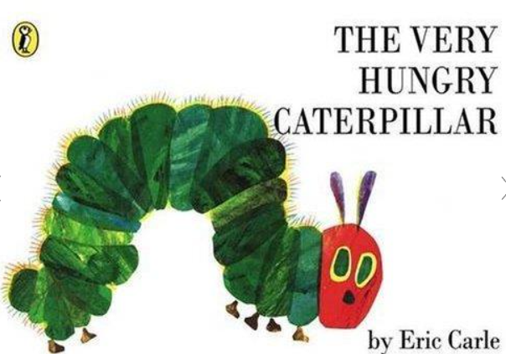
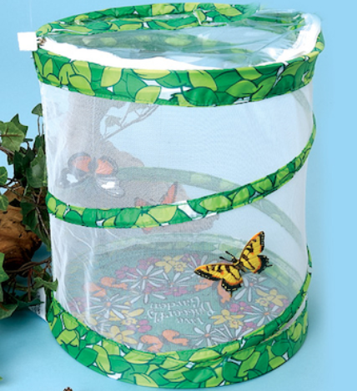
Text: The Very Hungry Caterpillar
Key Vocabulary
Egg
Caterpillar/Larvae
Butterfly
Chrysalis/Pupa
Cocoon
Healthy
Sunflower
Tall
Short
Pattern
Grow
Light
Observe
Other books:
Dear Zoo
Titch and the Sunflower
When I Grow Up: Farmer
Mad About Minibeasts
Where oh Where is Rosie’s Chick?
Skills/Learning:
I can match a numeral to the correct group of objects.
I can compare different amounts and lengths using vocabulary or more than/fewer than, tall, short.
I can identify and extend repeating patterns and spot a mistake.
I can use a range of new vocabulary linked to my topic.
I can begin to write some letters correctly.
I can understand a range of questions including who, what, where, why and how.
I am developing good control when holding a pencil.
I can look after the natural environment and living things in it.
I can talk about the changes I see in plants and animals.
Year : Nursery
Big Q: How do animals change as they grow?
Experiences and Visits:
White Post Farm visit and Parent Drop In
Butterfly Garden – grow our own Butterflies
Planting Seeds
1

