Slide 1

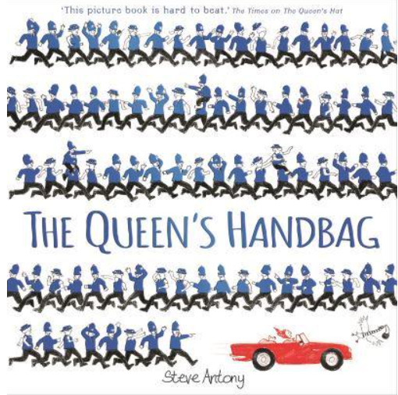
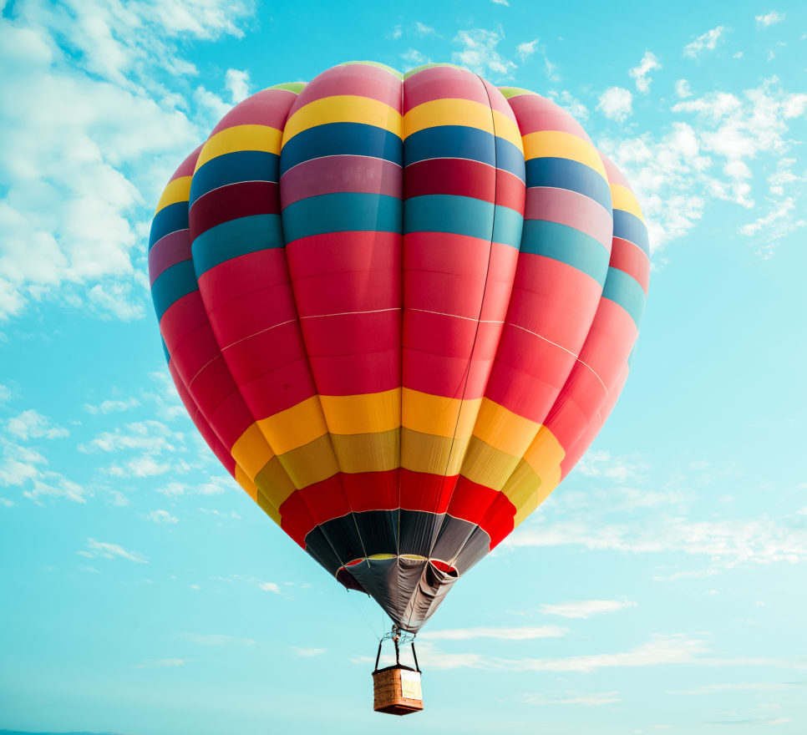
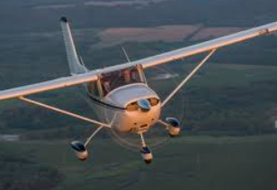
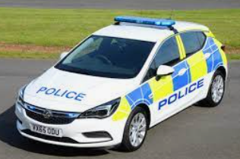
Wheels, Wings and
Moving Things
Key Vocab
Transport
Great Britain
Stonehenge
Map
Cliff
The White Cliffs of Dover
The World
Globe
France
Paris
New York
America
Statue of Liberty
Skills/Learning
I can answer how and why questions
I can begin to hear and write the initial, middle and final sounds in the words that I want to write
I can begin to write captions and attempt to write simple sentences
I can talk about and develop my own ideas
I can use new vocabulary
I can take on a role in my play
I can talk about different modes of transport
I can talk about where I live and how it is similar or different to another place in the world.
I can design and make my own mode of transport
I enjoy and increasing range of books
I can begin to look at number bonds to 10
To understand positional language
To recognise and talk about 2d and 3d shapes
Text
The Queens Handbag by Steve Antony
Emma Jane’s Aeroplane
Year : Reception
Big Q:
What is your favourite way to travel?
Where would you like to visit and why?
Visitors
Police Force
Rolls Royce STEM team
1

