Slide 1




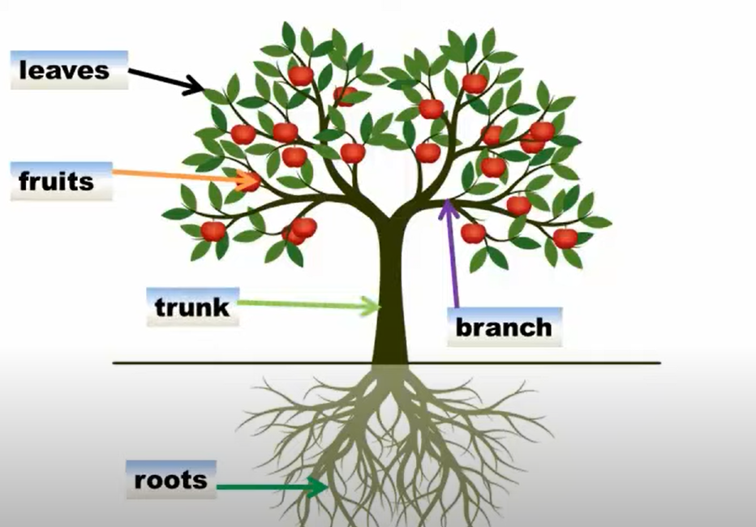
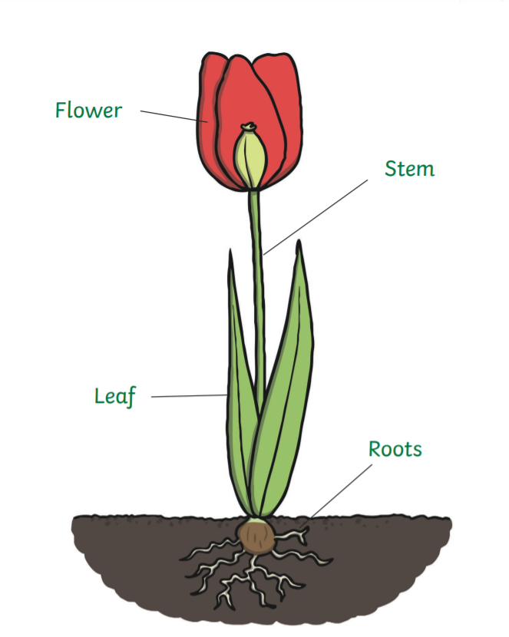
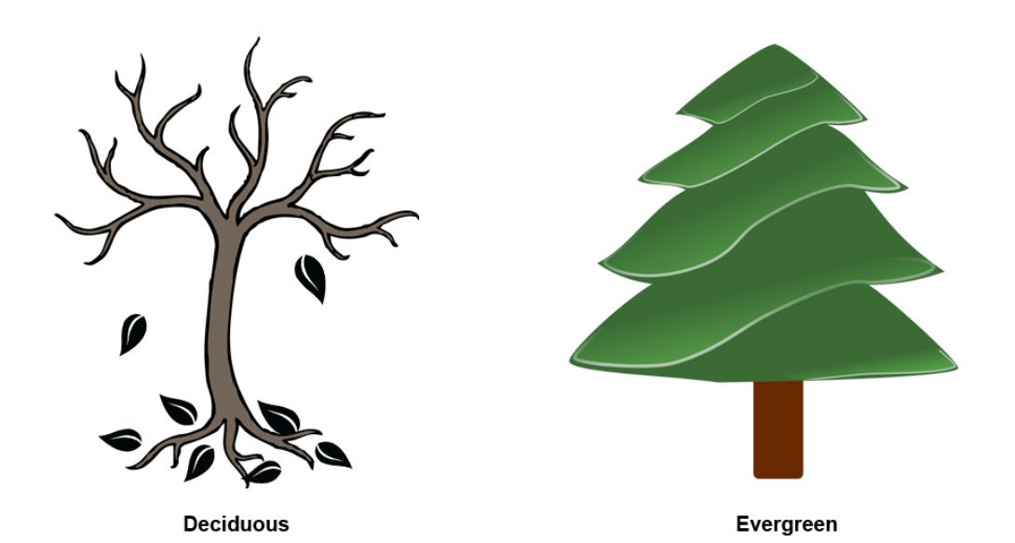
Skills/Learning:
We will explore variety of common flowering plants, including trees.
Look at leaves, seeds and nuts to identify trees growing in the UK.
Sort trees in different ways introducing deciduous and evergreen.
Consider why trees are important to the planet and environmental issues.
Structure of trees and plants.
We will be growing carrot tops, mustard, cress, pulses and beans!
Grow bulbs in water so that you can see the roots system to discover if the root or shoot comes first.
Text
There was a very little gardener who had to work very hard to keep his garden alive and well. But no matter how hard he worked, he was too little and the garden too big. He is certainly going to need some help if the garden is to survive…
Key Vocab
Growing | Changing and getting bigger
Plants | One of the groups of living things that use sunlight for energy
Petals | Bright outer part of a flower.
Berry | A small roundish juicy fruit.
Seed | Part of a plant that can grow into another plant.
Trees | A woody plant with a trunk.
Blossom | A flower or a mass of flowers, especially on a tree or bush.
Bark | The outside of a tree.
Deciduous | A tree that sheds its leaves.
Evergreen | A plant that keeps green leaves.
Growing
Big Question:
How can we tell plants apart?
Parts of plants key vocab:

