Slide 1
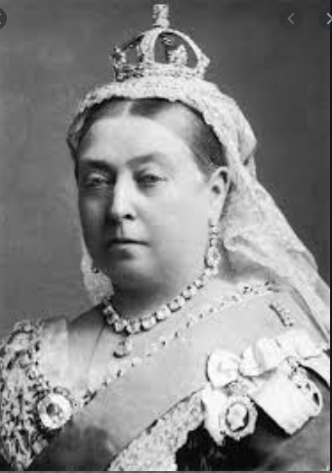
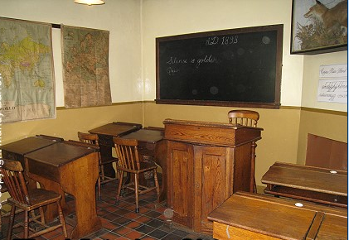
Year 2: Spring 2
What was life like in the Victorian era?
Key Vocab
Decade – 10 years
Centuries – 100 years
Era – A long period of history.
Reign – Rule as a monarch.
Empire – a group of countries ruled by a single monarch
Chronological – following the order in which they occurred.
Timeline – a period of time on which important events are marked.
Monarchy – the head of the country e.g. king or queen.
Slate – A thin piece of hard material used for writing on.
Drill – Physical exercise where formal orders were shouted by the teacher.
Cane – A long stick used to punish children.
Key Text:
Victorians (factual) – The Victorians lived in a time of great progress and change with the growth of the British Empire, great engineers, inventors and writers! We’ll learn about the home and work life of people in Victorian Britain, and the changes in medicine and transport.
Key Knowledge
To learn about the life of Queen Victoria and how her reign shaped and changed life today.
To discuss what school life was like in the Victorian times.
To ask questions about what life was like in the Victorian times.
Queen Victoria became Queen.
Alexander Bell invented the telephone.
Prince Albert died
1837 1840 1861 1870 1876 1901
The first postage stamps came into use.
Queen Victoria married Prince Albert
Schools provided for 5-10 year olds.
Queen
Victoria
died.
Experiences and Visits
Victorian experience day

Slide 2
