Slide 1
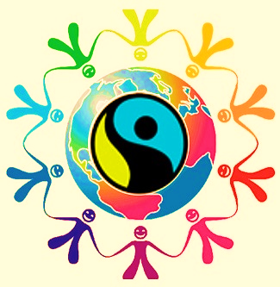
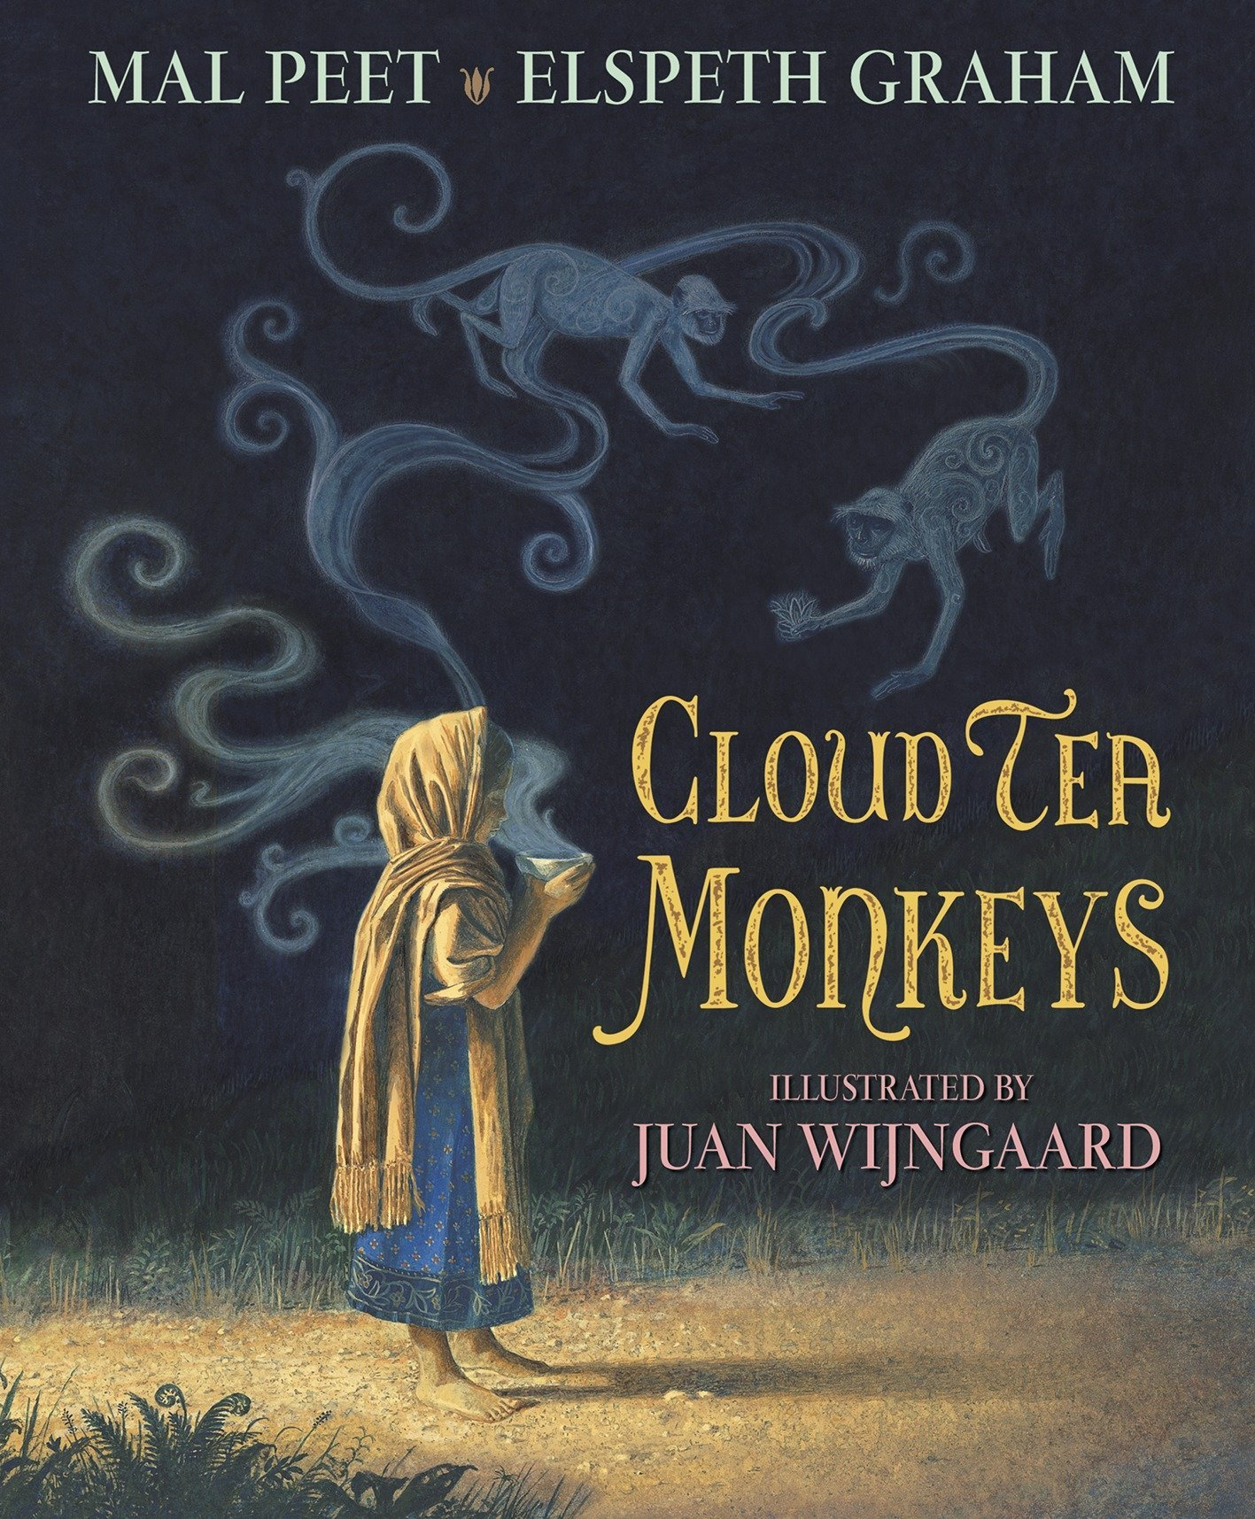
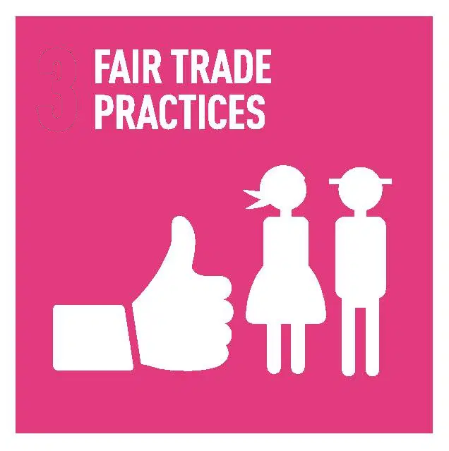
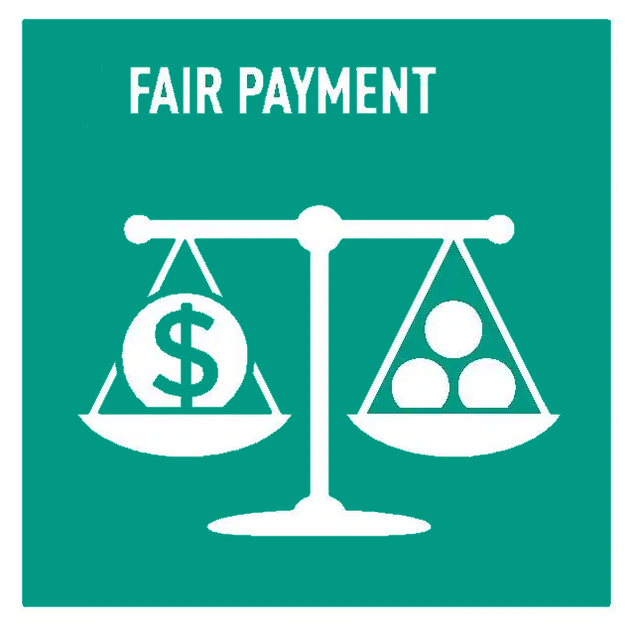
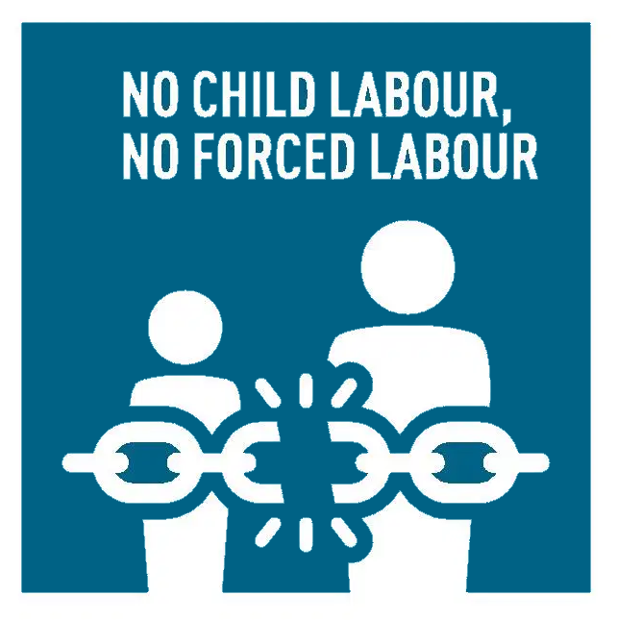
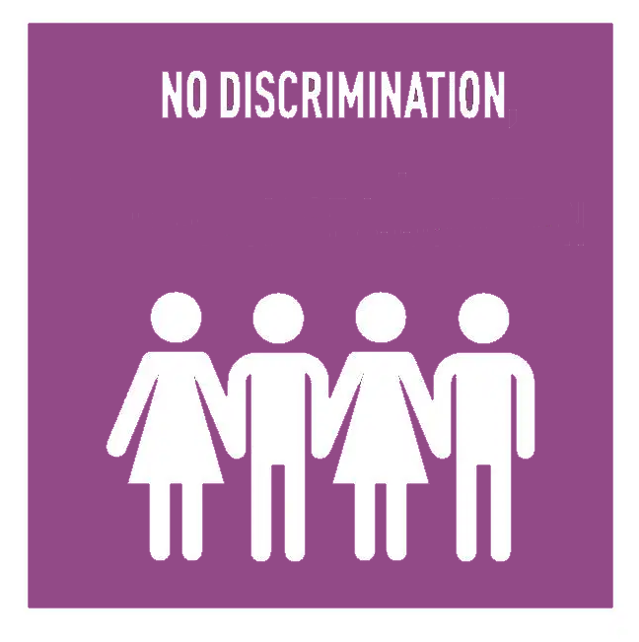
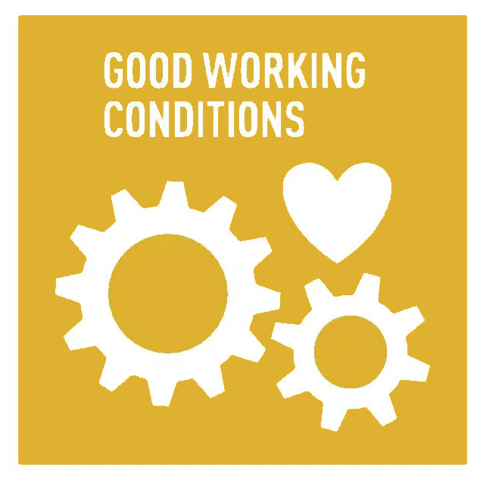
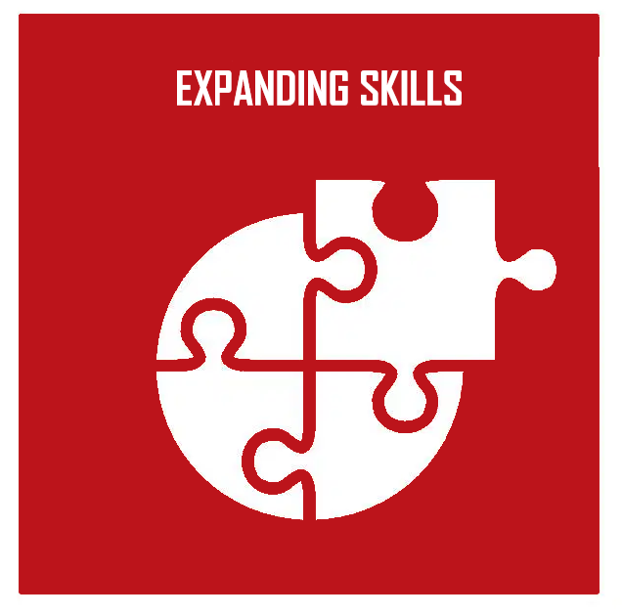

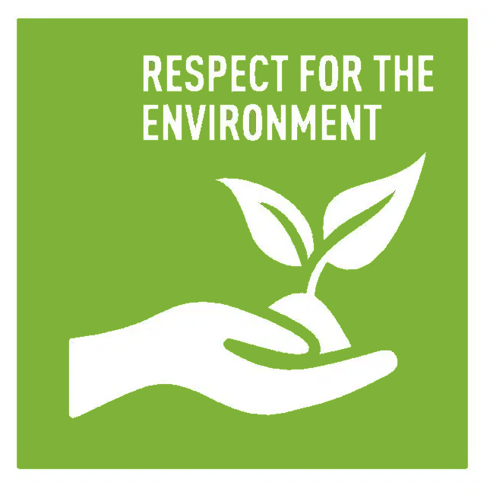
Fairtrade
Big Q: What impact DOES FAIR TRADE HAVE ON LOCAL COMMUNITIES?
Key Vocabulary:
Fairtrade | An organisation supporting a better wage for farmers
fair trade | Trading that brings a better standard of living to farmers in poorer countries
produce | Farm products such as bananas
developing world | Areas of the world that are poor and do not have many industries
Fairtrade premium | Money paid into a fund for farmers to use to improve their local community
poverty cycle | When people cannot get out of poverty (being poor)
certified | Recognised as meeting a set standard
sustainability | Able to keep protecting the environment and maintaining income
exploited | Using somebody in an unfair way (such as child labour)
child labour | Using children to work
Text: Cloud Tea Monkeys by Mal Peet and Elspeth Grayham
Stories from India
A range of poetry
Experiences
Fairtrade Day
CO-OP visit to research cost of Fairtrade products
Chembakolli Day
Knowledge
Fairtrade means trading that brings a better standard of living to farmers in poorer countries.
Fairtrade produce is from specific countries
Fair trade has benefits for farmers and their communities
Chembakolli is a village in India where Fairtrade products are grown
Countries with Fairtrade initiatives are different from the UK
What people want and what people need can be very different
Fair and equal can have different meanings
To locate places on a world map
1

