Slide 1
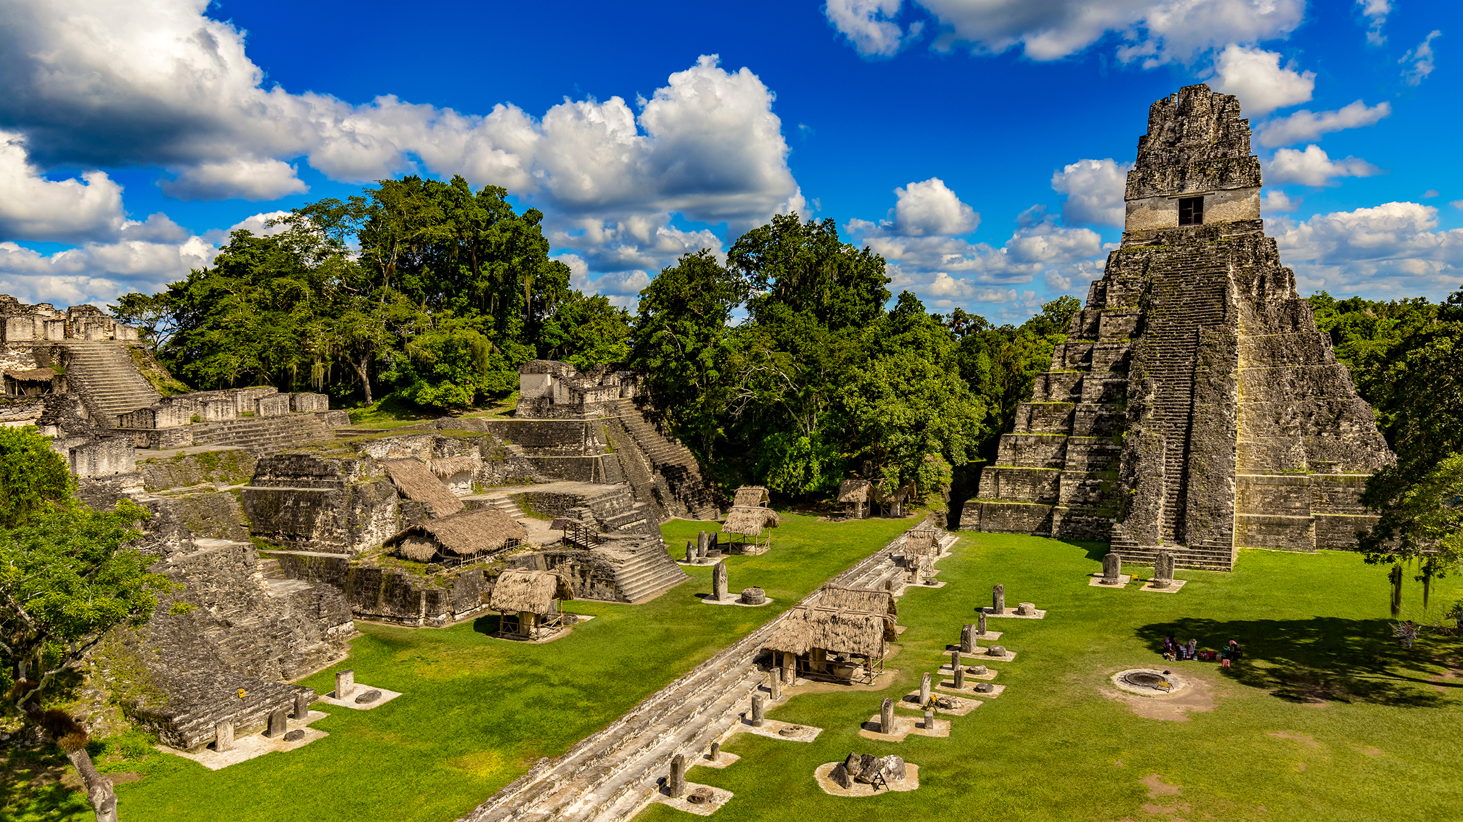
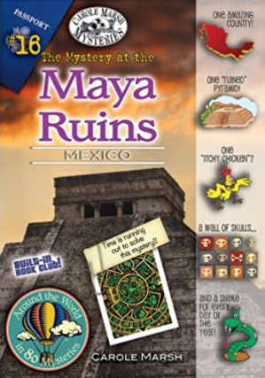
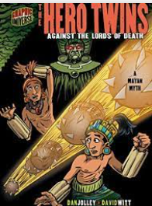
Key Knowledge
The Maya lived in many countries in the South of the continent North America.
The Maya arrived in Central American jungles around 12,000 years ago.
There are around 6 million Maya living today, with the largest groups living in Mexico.
The Maya had an advanced farming method for their time, called terrace farming.
The Maya were experts at astronomy and made some of the very first calendars by tracking the sun, moon, stars and planets.
The Maya ate many different types of food. There main food source was maize, which they even worshipped!
The Maya did extreme things to be fashionable, such as pressing babies heads, making children become permanently cross-eyed, carving their teeth to make them pointed and more!
Key Texts
The Mystery at the Maya Ruins, written by Carole Marsh, explores a family’s intriguing and dangerous journey through the Maya Ruins.
The Hero Twins, is an exciting adventure of how two brothers overcome the forces of the Maya underworld.
Key Vocabulary
ancestor | a person who someone has descended from many generations ago.
archaeologist | a scientist who looks at man-made objects to find things about people in history.
civilisation | a group of people with their own languages and way of life.
excavate | to make a hole or hollow place in by digging.
exploration | search an unfamiliar area to learn about it.
Mayan | a large family of languages spoken in Central America and Mexico.
merchant | someone who trades goods.
mural | a painting that has been directly painted on a wall.
quetzal | a bird of the trogon family, which has brightly-coloured feathers.
relic | an object of historical interest that has survived for a long time.
ritual | a religious or solemn ceremony.
territory | an area of land that someone rules.
Magnificent Maya
Year 5: Spring 2 Big Question: How does/did the Maya adapt to its environment?
1100BC – The first hunter gatherers settle along the Pacific Coast and then expand into central highlands.
700BC – Mayan writing is developed in Mesoamerica.
300BC – Nobles and Kings are made rulers.
683AD – Pakal the Great of Planque dies and is buried in the Temple of Inscriptions.
1000BC 500BC 500AD 1502AD
800BC – Village farming and trade becomes established throughout the Maya Region.
400BC – Earliest solar calendars are carved in stone.
100BC – The first pyramids are built.
1502AD – First contact with Europeans made.

